Slide 1

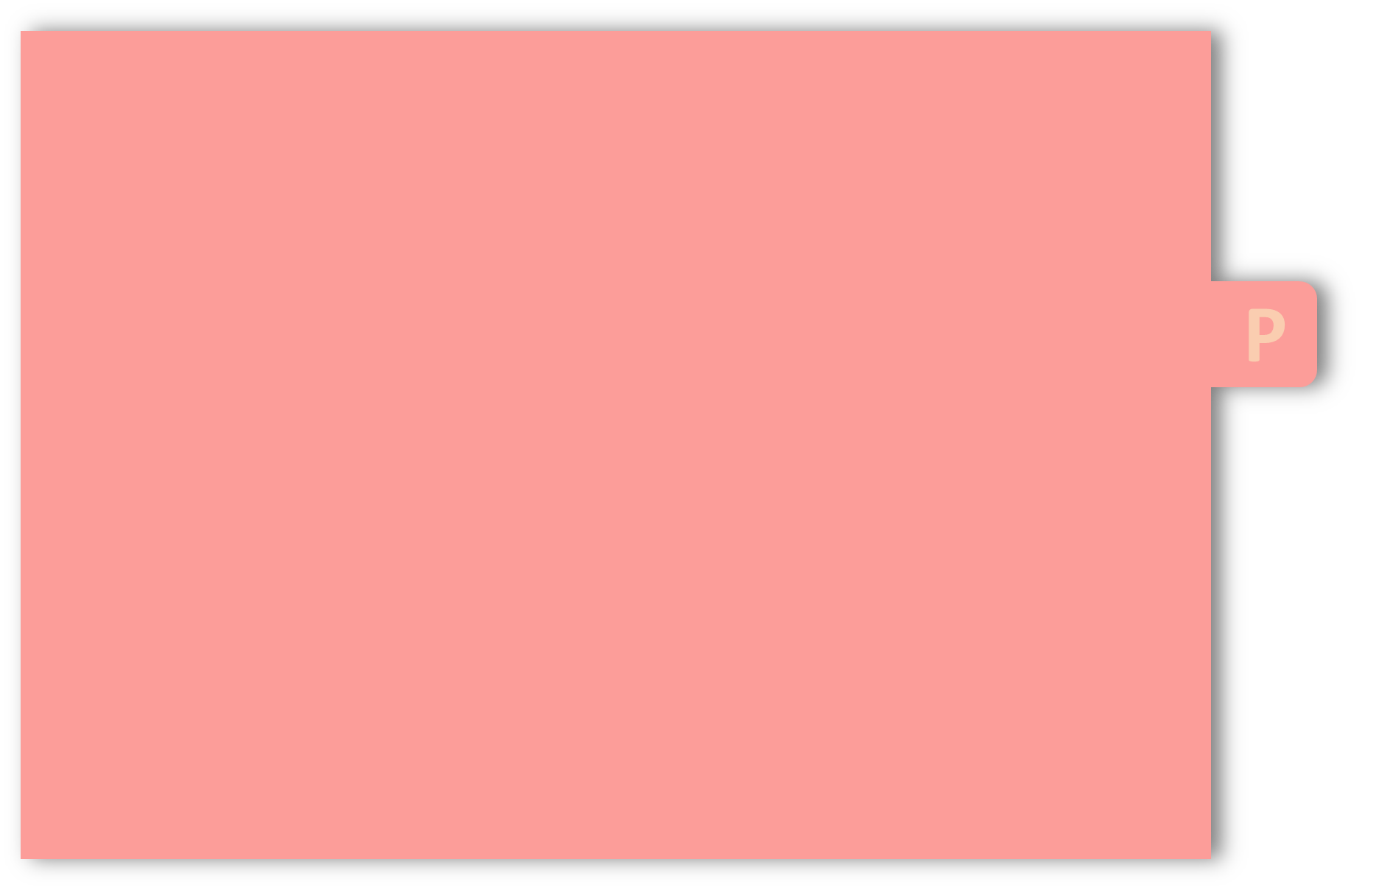
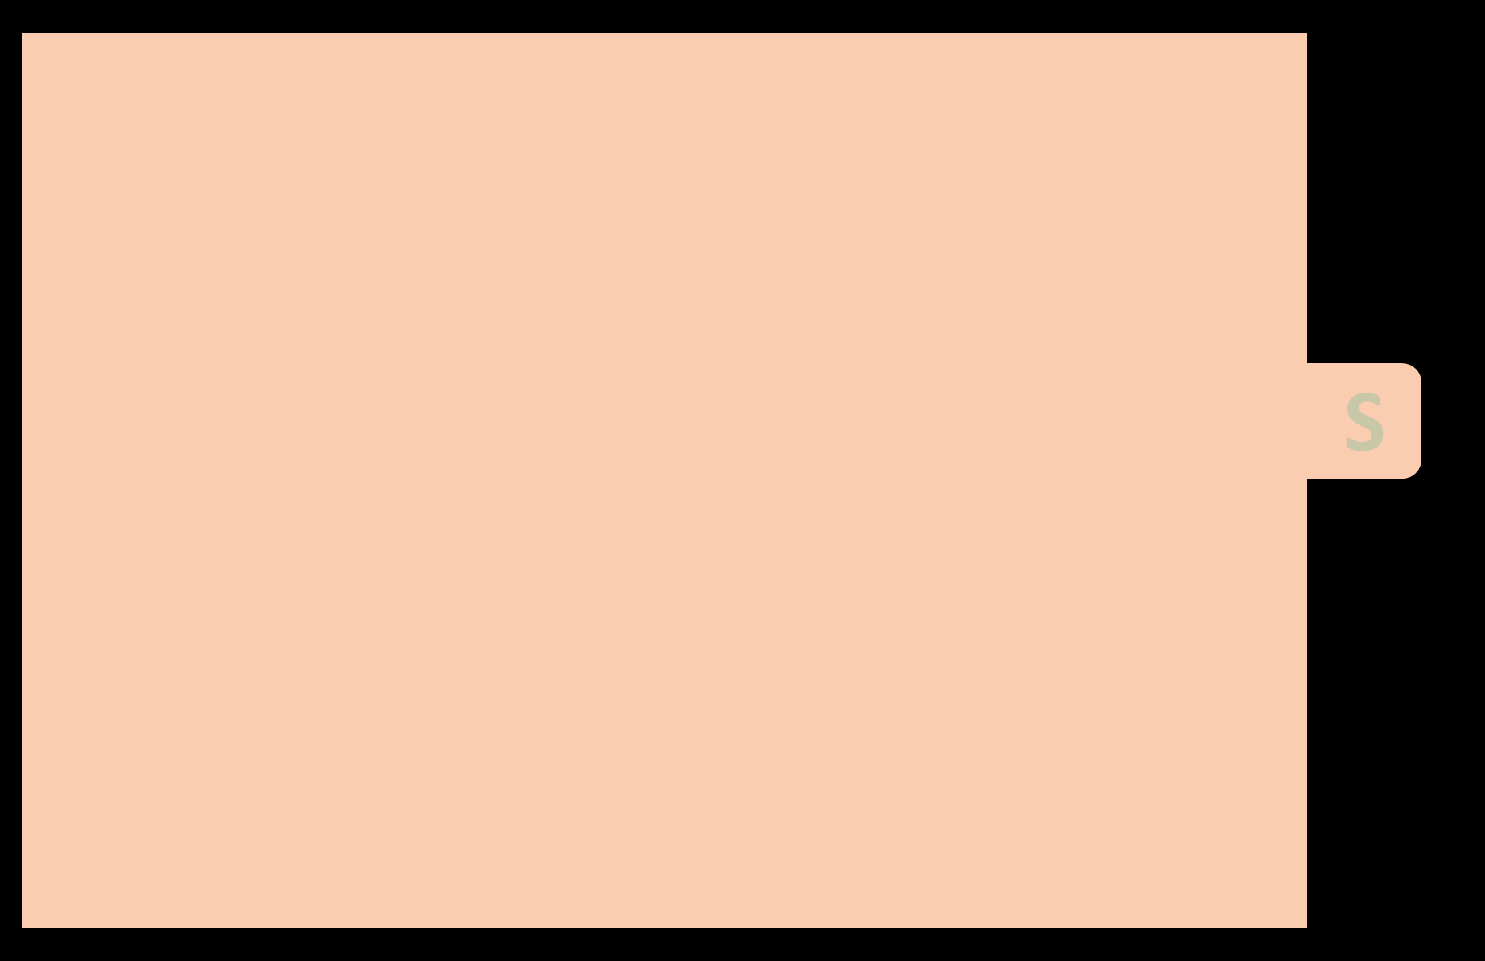
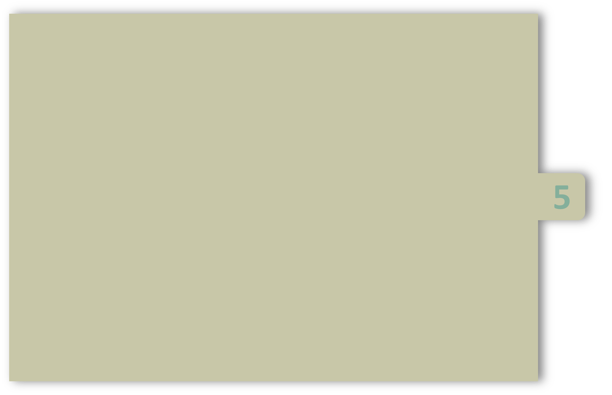
UNIT-5
Structures:
        Definition
        Declaration
        Accessing the structure elements
        Array of structures
        Arrays with in structures
        pointer to structure
        passing structure to function
        nested structures
        unions

Slide 2
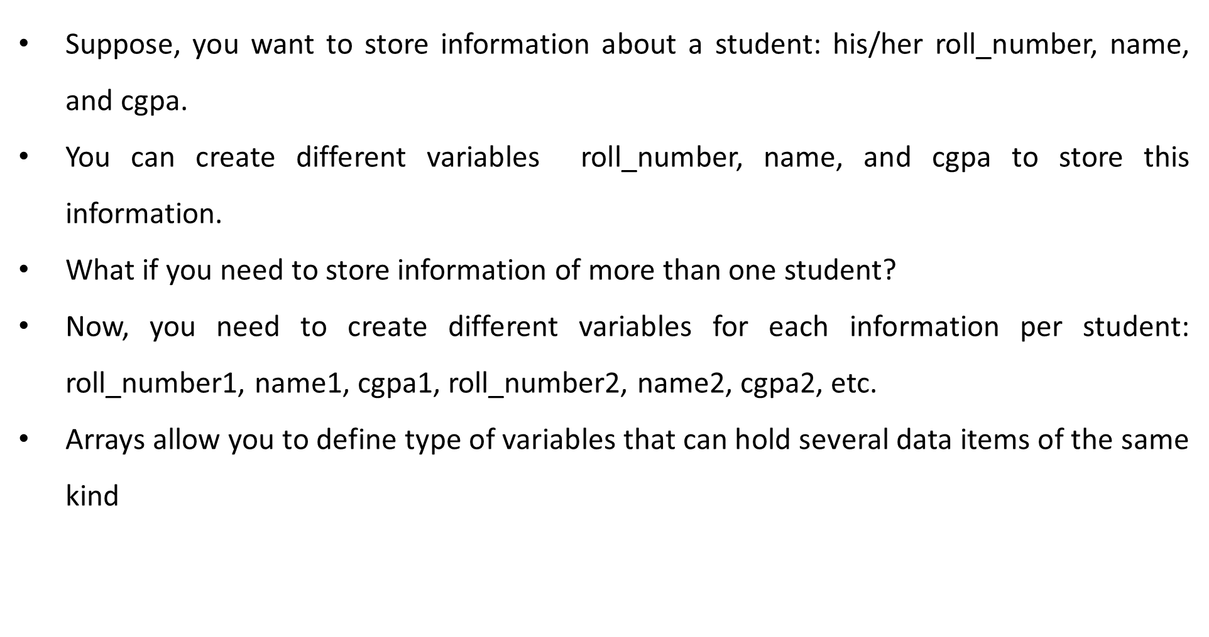
Why structures in C?

Slide 3
Definition of Structure
Structure is a user-defined data type in C language which allows us to combine data of different types together.
Structures are used to represent a record, suppose you want to keep track of your students in a class.
You might want to track the following attributes about each student:
        roll_number
        name
        cgpa

Slide 4
Declaration a Structure
To declare a structure, you must use the struct statement.
The format of the struct statement is this:
Syntax: struct structure-name { Data member 1; Data member2 ; ... Data member n ; } ; | Example: struct student { int roll_numer; char name[20]; float cgpa; } ;

Slide 5
Declaration of Structure
The structure tag is optional and each data member is a normal variable, such as int roll_number; or float cgpa; or any other valid variable definition.
At the end of the structure's definition, we have to mention semicolon.

Slide 6
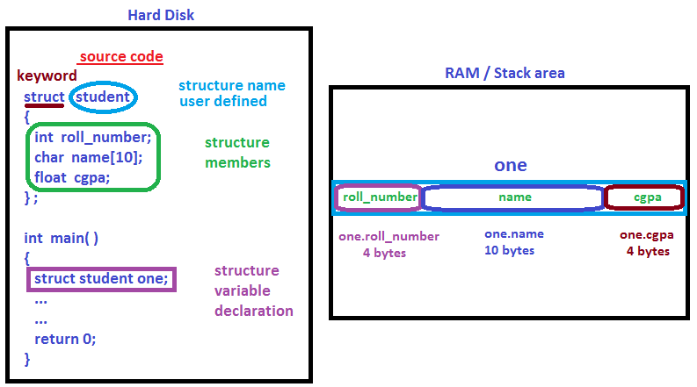

Slide 7
How to Create structure variables
When a struct type is declared, no storage or memory is allocated.
To allocate memory of a given structure type and work with it, we need to create variables.
Syntax: struct structure-name { Data member 1; Data member2 ; ... Data member n ; } structure variables; | Example: struct student { int roll_numer; char name[20]; float cgpa; } s1;

Slide 8
How to initialize?
Structure members cannot be initialized with declaration. For example the following C program fails in compilation.
struct student { int x = 0; // COMPILER ERROR: cannot initialize members here int y = 0; // COMPILER ERROR: cannot initialize members here };
The reason for above error is simple, when a data type is declared, no memory is allocated for it. Memory is allocated only when variables are created.

Slide 9
How to initialize?
Structure members can be initialized using curly braces ‘{}’.
Static: struct student varaible name={list of items}; Ex: struct student s1={501,”Sanket”,9.8};

Slide 10
Accessing Structure Members
There are two types of operators used for accessing members of a structure.
      Member operator ( . )
      Structure pointer operator ( -> )
To access any member of a structure, we use the member access operator (.).

Slide 11
#include<stdio.h> #include<string.h> Struct student { int rno; char name[20]; float cgpa; } s; void main( ) { clrscr( ); s.rno = 56; printf( “Num: %i”, s.rno); strcpy( s.name, “Sohel"); printf( “Name:%s”, s.name); s.cgpa = 8.2; printf(“cgpa:%f”, s.cgpa); } Output: Num: 56 Name: Sohel Cgpa: 8.2 | #include<stdio.h> #include<string.h> Struct student { int rno; char name[20]; float cgpa; } s = { 56, “Sohel”, 8.2}; void main( ) { clrscr( ); printf( “Num: %i”, s.rno); printf( “Name:%s”,s.name); printf(“cgpa:%f”, s.cgpa); } Output: Num: 56 Name: Sohel Cgpa: 8.2

Slide 12
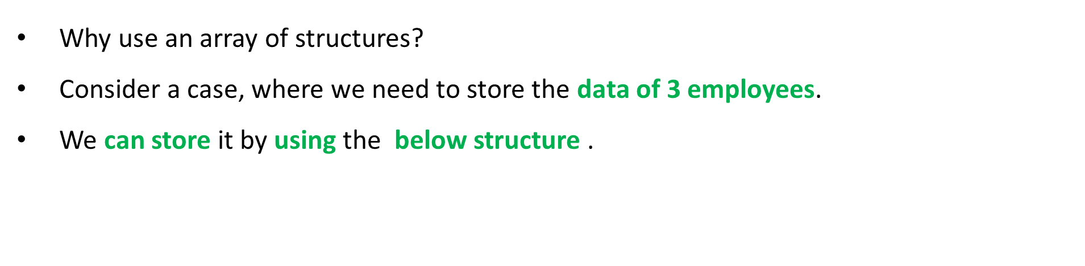
Why Array of Structures?
Ex:
struct employee
{
int id;
char Name[5];
float salary
} emp1, emp2, emp3;

Slide 13
Why Array of Structures?
In the above program, we have to store data of 3 employees in the structure.
However, the complexity of the program will be increased if there are 20 employees.
In that case, we will have to declare 20 different structure variables and store them one by one.
This will always be tough since we will have to declare a variable every time we add an employee.
Remembering the name of all the variables is also a very tricky task.

Slide 14
Array of Structures
C enables us to declare an array of structures by using which, we can avoid declaring the different structure variables.
An array of structures can be defined as the collection of multiple structures variables where each variable contains information about different entities.
The arrays of structures are used to store information about multiple entities of different data types.

Slide 15
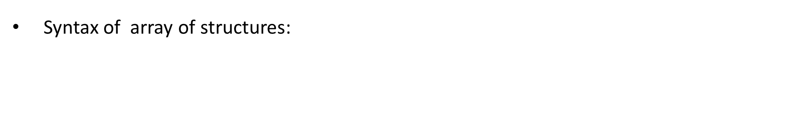
Array of Structures
Syntax:
struct structure-name
{
Data member 1;
Data member2 ;
...
Data member n ;
} array name[SIZE] ;
Ex:
struct employee
{
int id;
char Name[5];
float salary
} emp[3];

Slide 16
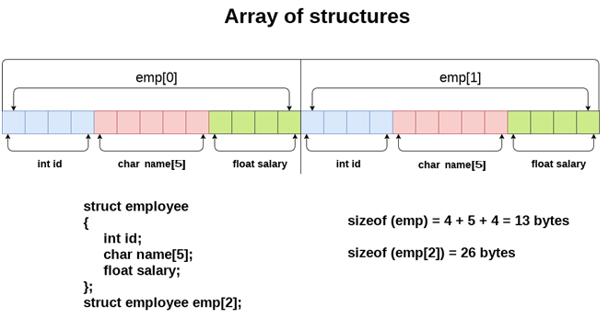
Array of Structures

Slide 17
#include<stdio.h> #include<string.h> struct employee { int id; char name[15]; float salary; } emp[3]; int main( ) { int i; printf(“Enter 3-employees data: “); for(i=0; i<3; i++) { scanf(“%d”, &emp[ i ].id ); scanf(“%s”, emp[ i ].name ); scanf(“%f”, &emp[ i ].salary ); } | printf(“Employee data: “); for(i=0; i<3; i++) { printf(“\n emp[%i] data: ”, i); printf(“%i”, emp[ i ].id ); printf(“%s”, emp[ i ].name ); printf(“%f”, emp[ i ].salary ); } return 0; } Output: Enter 3-employees data: 56 abc 777 57 pqr 888 58 xyz 999 Employee data: emp[0] data: 56 abc 777 emp[1] data: 57 pqr 888 emp[2] data: 58 xyz 999

Slide 18
Passing Structures to a function
You can pass a structure as a function argument in very similar way as you pass any other variable .
You would access structure variables in the similar way as you have accessed the normal variable.

Slide 19
#include <stdio.h> #include <string.h> struct student { int rno; char name[10]; }; void show( struct student st2 ); /* function declaration */ int main( ) { struct student s1; s1.rno = 111; strcpy( s1.name, “Akhil"); show( s1 ); return 0; } void show( struct student s2 ) { printf( "student rno : %i", s2.rno); printf( "student name : %s", s2.name); } Output: student rno : 111 student name: Akhil

Slide 20

Pointers to Structures
You can define pointers to structures in very similar way as you define pointer to any other variable as follows:
Now, you can store the address of a structure variable in the above defined pointer variable.
To find the address of a structure variable, place the & operator before the structure's name as follows:
Syntax
struct tagname *pointername;
Example
struct books *p1;
Syntax
Pointer name= &structure variable name;
Example
p1= &book1;

Slide 21
Pointers to Structures
To access the members of a structure using a pointer to that structure, you must use the -> operator .
Syntax
Pointer name→data member name;
Example
P1→subject;

Slide 22
#include <string.h> struct books { char subject[100]; int book_id; }; void show( struct books *book2); /* function declaration */ int main( ) { struct books book1; strcpy( book1.subject, "C Programming"); book1.book_id = 111; show( &book1 ); return 0; } void show( struct books *book2) { printf( "subject : %s", book->subject); printf( "Book book_id : %d", book->book_id); } Output: subject : C Programming book_id : 111

Slide 23
If we have a pointer to structure, members are accessed using arrow ( -> ) operator.
#include<stdio.h>
struct point
{
int x, y;
};
int main()
{
struct point p1 = {1, 2};
struct point *p2 = &p1; // p2 is a pointer to structure p1
printf("%d %d", p2->x, p2->y); // Accessing structure members using structure pointer
return 0;
}

Slide 24
Nested Structures
You can create structures within a structure in C programming.
Nested structures means, that one structure has another structure as member variable.
struct address { char city[50]; int pincode; } ; struct student { struct address add; char name[15]; int age; } st; Accessing structure members: strcpy(st.add.city,”vizag”); st.add.pincode=123 | struct student { char name[15]; int age; struct address { char city[50]; int pincode; } add; } st; Accessing structure members: strcpy(st.add.city,”vizag”); st.add.pincode=123

Slide 25
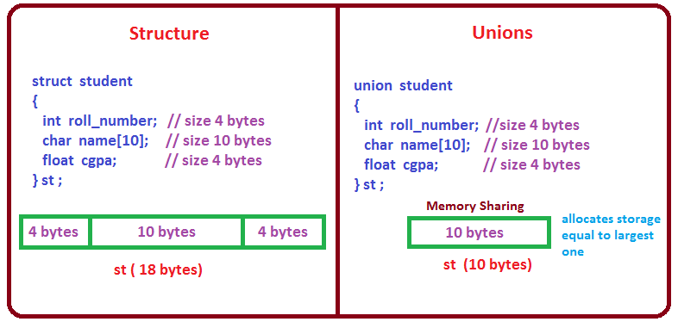
Unions

Slide 26
Unions
A union is a special data type available in C that enables you to store different data types in the same memory location.
You can define a union with many members, but only one member can contain a value at any given time.
Unions provide an efficient way of using the same memory location .
In union, all members share the same memory location.

Slide 27
Defining a Union
The format of the union statement is as follows:
union name { member definition; member definition; } variable1, variable2….. ; | union Data { int i; float f; char str[20]; } d1;

Slide 28
Unions
At the end of the union's definition, before the final semicolon, you can specify one or more union variables .
Here is the way you would define a union type variable d1 which has the three members i, f, and str.
This means that same memory location can be used to store multiple types of data.
For example, in above example d1 will occupy 20 bytes of memory space because this is the maximum space which can be occupied by character string.

Slide 29
Unions
#include <stdio.h> #include <string.h> union Data { int i; float f; char str[20]; }; int main( ) { union Data d1; printf( "Memory size occupied by data : %d", sizeof(d1)); return 0; } Output: Memory size occupied by data : 20

Slide 30

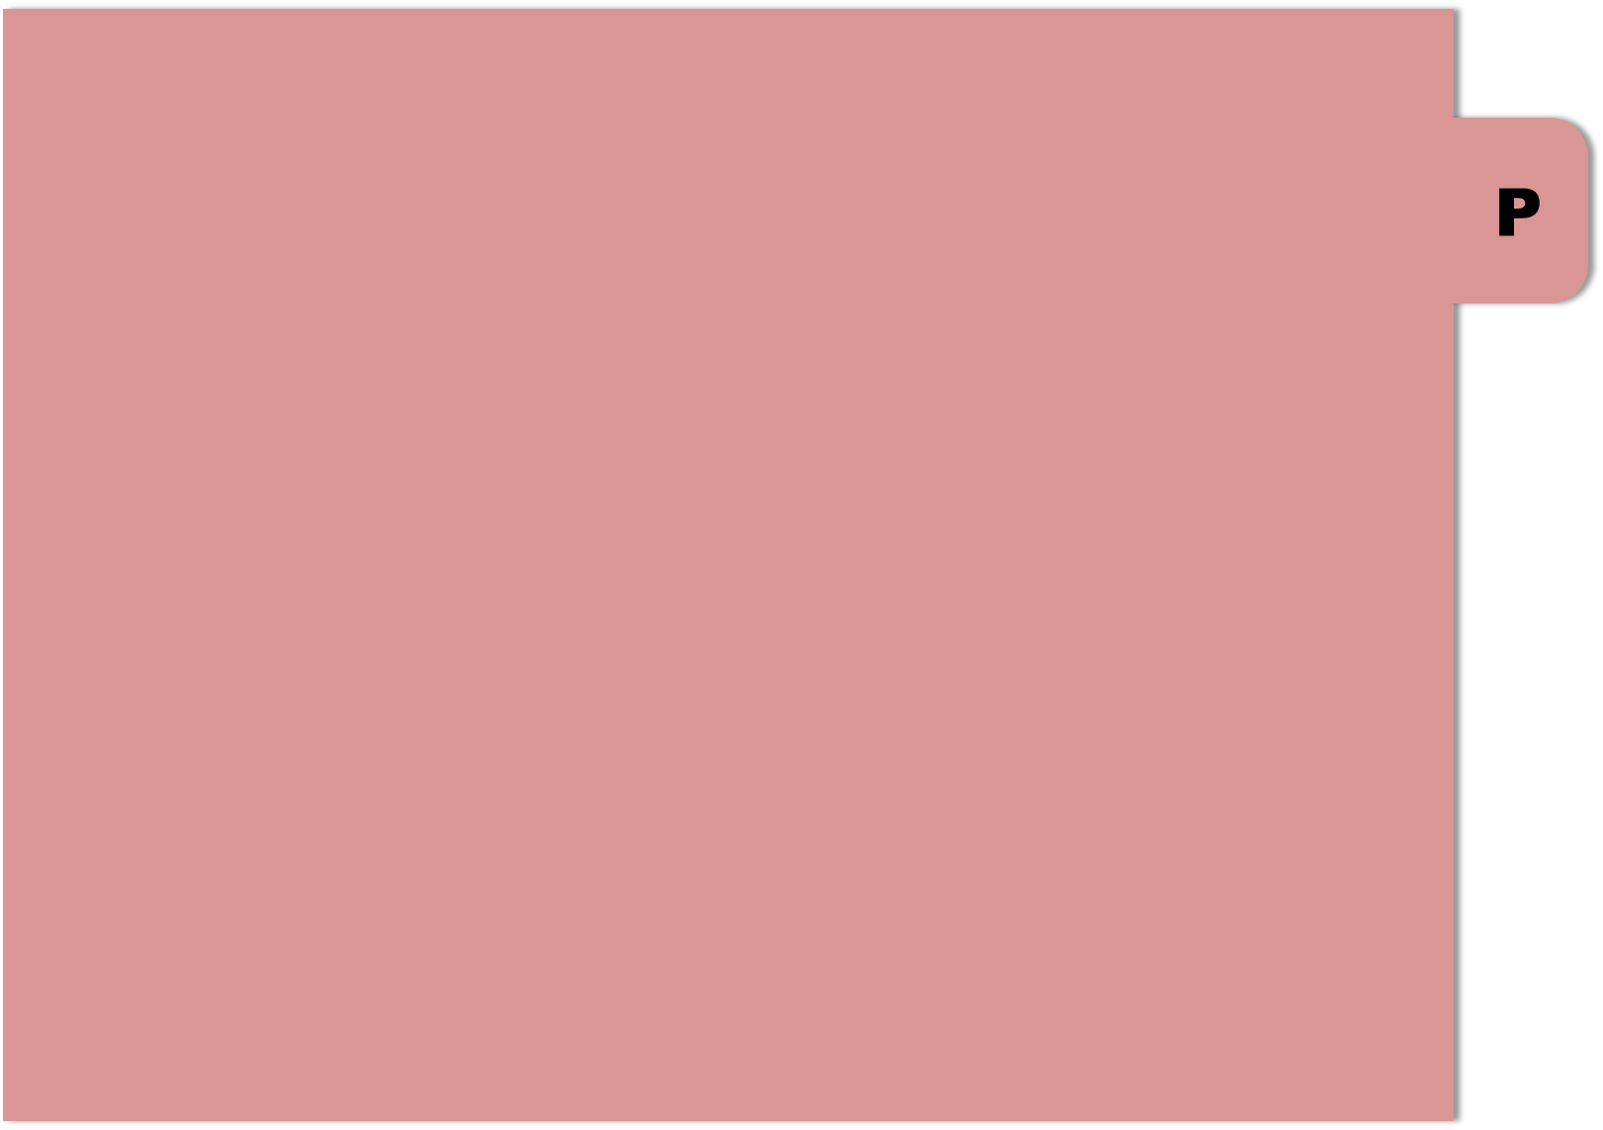

THANK YOU

